Slide 1
Easy MDF Door Maker

Slide 2
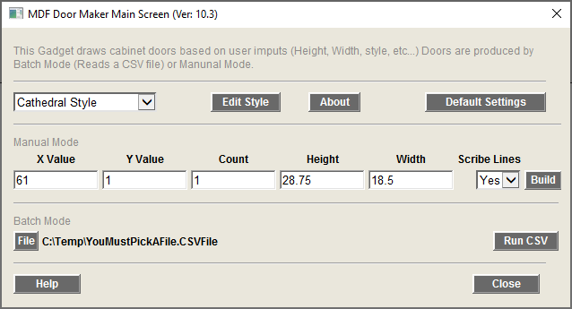
Main Screen
Edit Selected Door Style
About Gadget
Edit Defaults Setting
Select Door Style
Draw Door (s) based on the setting shown here
Set the X value for Draw Door
CSF File To Read
Run the Batch Mode Process
Set the Y value for Draw Door
Set the number of Doors drawn
Add Scribe Lines

Slide 3
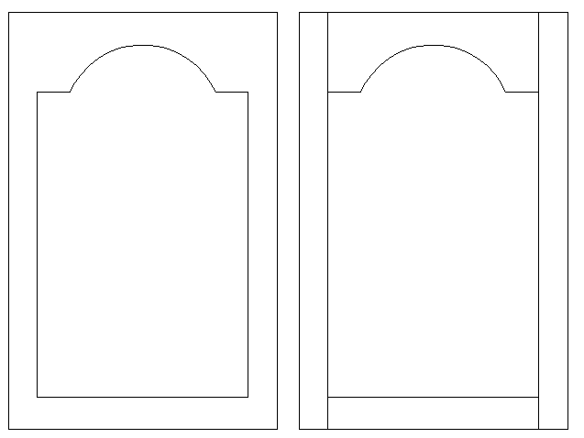
Scribe Lines
Without Scribe Lines
With Scribe Lines

Slide 4
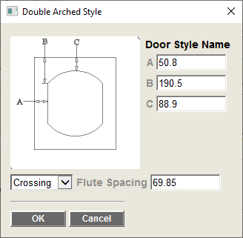
Style Edit Screen
Enter Values for the Items listed in the image

Slide 5
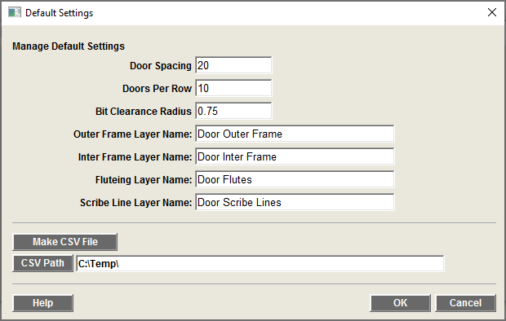
Defaults Screen
Distance Between Doors (See drawing)
Number of Doors per Row in the drawing
Layer Names
Inter profile Bit Clearance
Makes a Seed CSV File (based on current drawing Units)
Select where to make the Seed CSV File

Slide 6
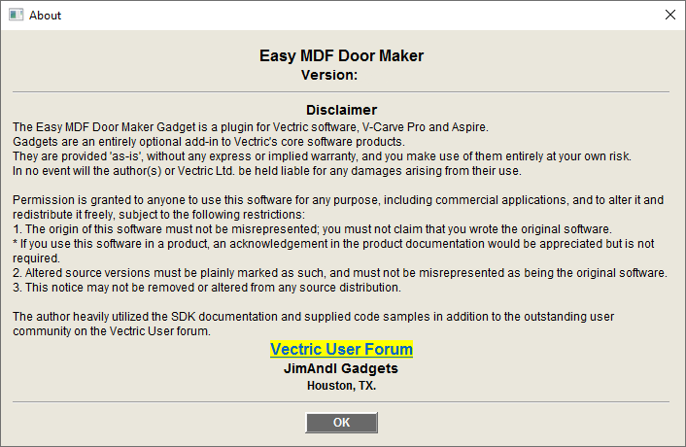
About Screen

Slide 7
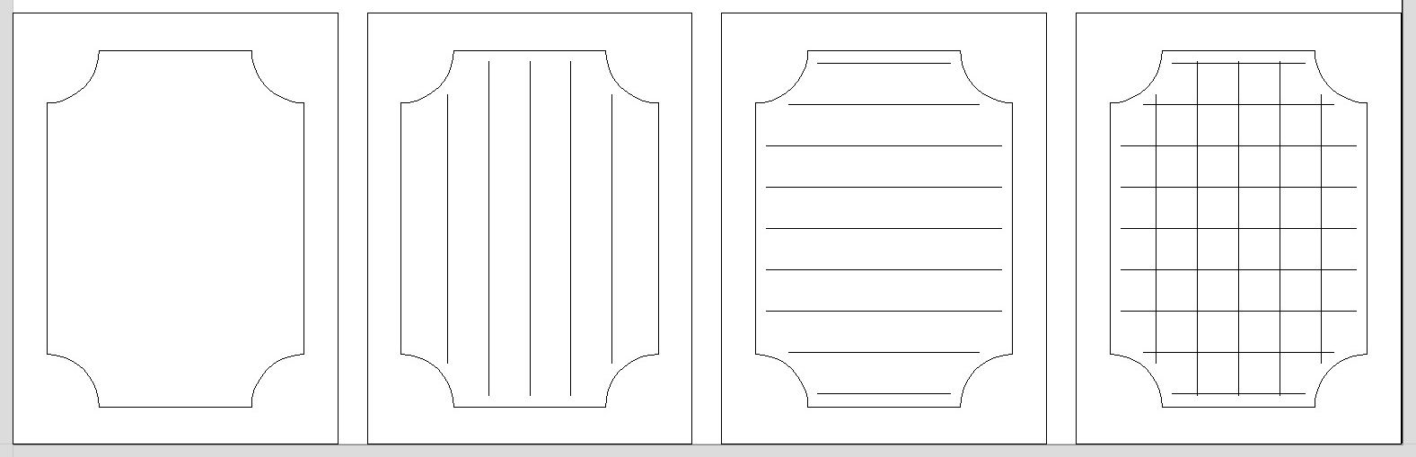
Fluting Options
Options:
None
Vertical
Horizontal
Crossing

Slide 8
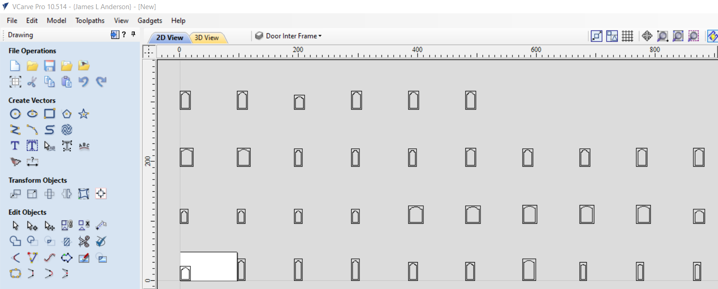
Drawing of Doors
Distance Between Door Value

Slide 9
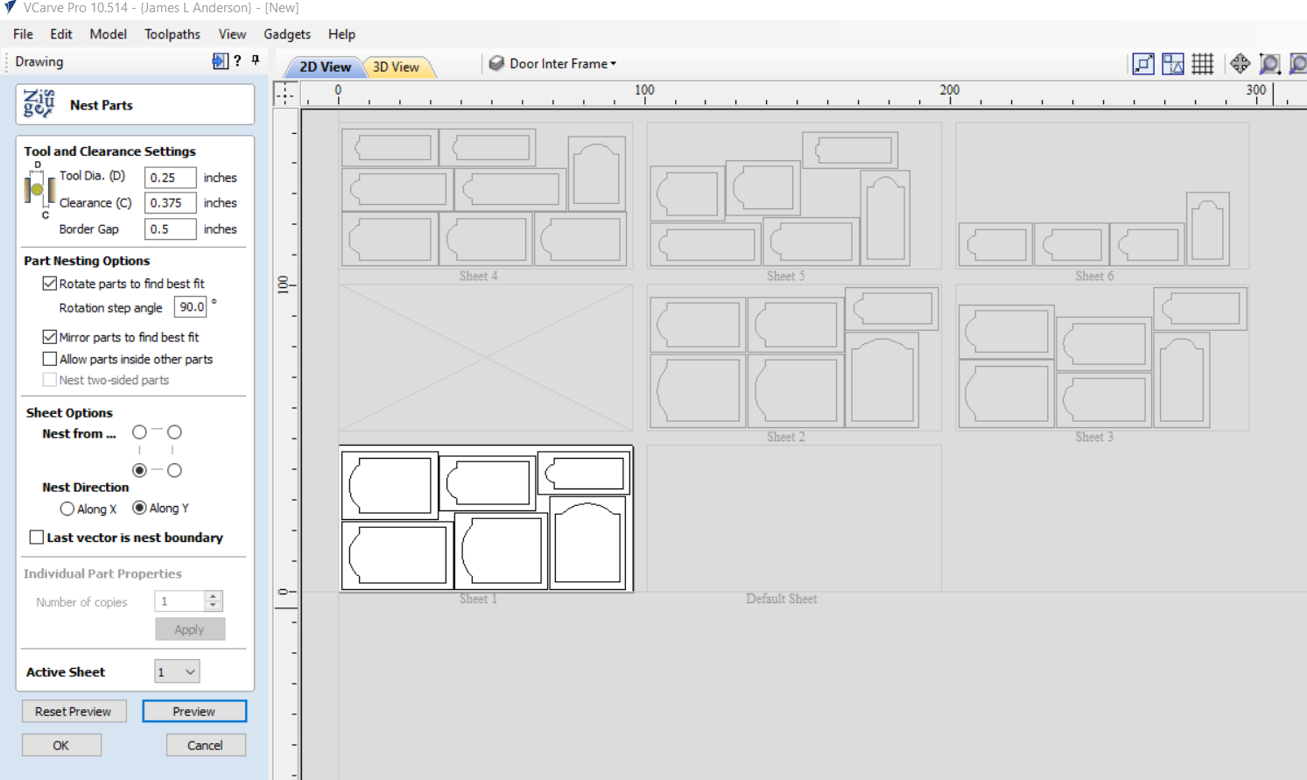
Using the Nesting Tool

Slide 10
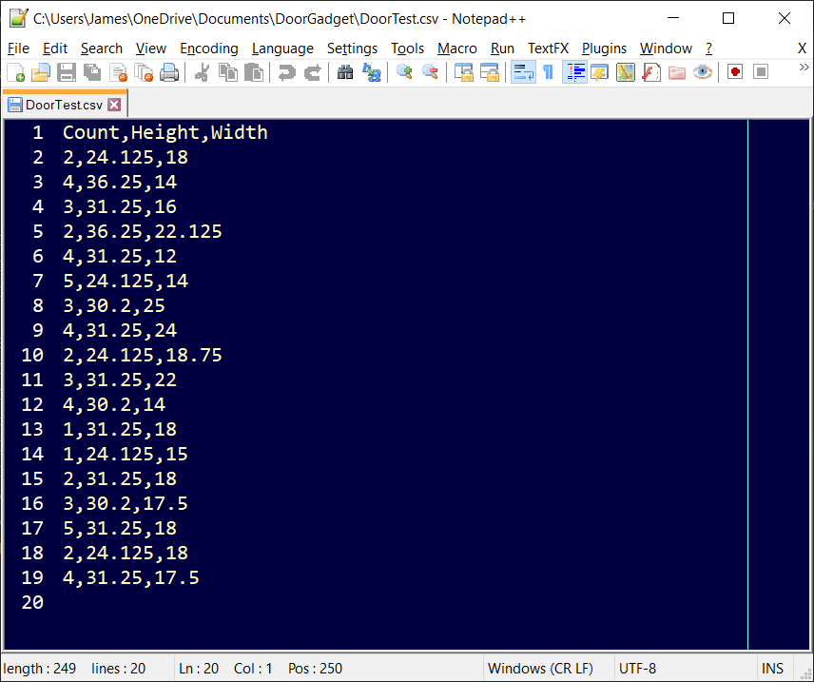
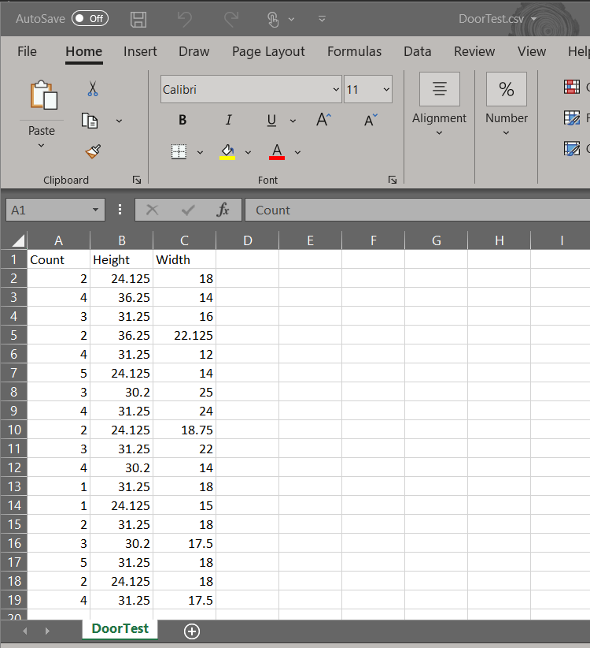
Edit CSV file in Excel or Text editor

Slide 11
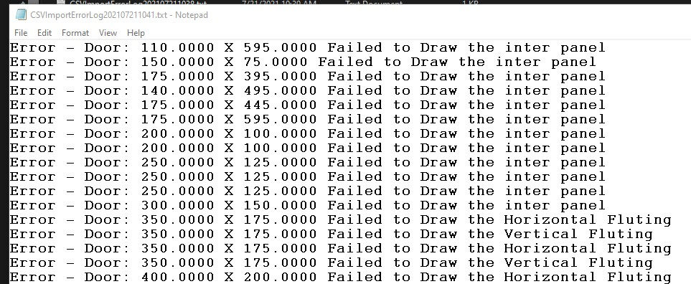
Error Log Report

